Slide 1
WiDS Datathlon 2020
Big Data Computing Project
2019-2020

Slide 2
We will cover the following topics
I split my project in 4 main parts.

Slide 3
We will cover the following topics
I split my project in 4 main parts.
Project description

Slide 4
We will cover the following topics
I split my project in 4 main parts.
Project description
Data exploration

Slide 5
We will cover the following topics
I split my project in 4 main parts.
Project description
Data exploration
Learning pipeline

Slide 6
We will cover the following topics
I split my project in 4 main parts.
Project description
Data exploration
Learning pipeline
Evaluation

Slide 7
Project description

Slide 8
Overview
WiDS (Women in Data Science) Datathlon 2020 is a completed competition on Kaggle

Slide 9
Overview
WiDS (Women in Data Science) Datathlon 2020 is a completed competition on Kaggle
It focuses on patient health through data from MIT’s GOSSIS (Global Open Source Severity of Illness Score) initiative

Slide 10
Overview
WiDS (Women in Data Science) Datathlon 2020 is a completed competition on Kaggle
It focuses on patient health through data from MIT’s GOSSIS (Global Open Source Severity of Illness Score) initiative
The challenge is to create a model that uses data from the first 24 hours of intensive care to predict patient survival

Slide 11
Data description
Kaggle has provided a dataset of more than 130,000 hospital Intensive Care Unit (ICU) visits from patients

Slide 12
Data description
Kaggle has provided a dataset of more than 130,000 hospital Intensive Care Unit (ICU) visits from patients
We have access to 5 files, which include some datasets and a dictionary

Slide 13
Files description
training_v2.csv - the training data, on which we are going train the model

Slide 14
Files description
training_v2.csv - the training data, on which we are going train the model
unlabeled.csv - the data without the target variable provided, and from which we are being asked to predict hospital death

Slide 15
Files description
training_v2.csv - the training data, on which we are going train the model
unlabeled.csv - the data without the target variable provided, and from which we are being asked to predict hospital death
samplesubmission.csv - a sample submission file in the correct format

Slide 16
Files description
training_v2.csv - the training data, on which we are going train the model
unlabeled.csv - the data without the target variable provided, and from which we are being asked to predict hospital death
samplesubmission.csv - a sample submission file in the correct format
solution_template.csv - a list of all the rows that should be in the submission

Slide 17
Files description
training_v2.csv - the training data, on which we are going train the model
unlabeled.csv - the data without the target variable provided, and from which we are being asked to predict hospital death
samplesubmission.csv - a sample submission file in the correct format
solution_template.csv - a list of all the rows that should be in the submission
WiDS Datathlon 2020 Dictionary.csv - supplemental information about the data

Slide 18
Tools
I used the following data analysis and machine learning tools:

Slide 19
Tools
I used the following data analysis and machine learning tools:
PySpark - dataframes and learning pipeline

Slide 20
Tools
I used the following data analysis and machine learning tools:
PySpark - dataframes and learning pipeline
Pandas, NumPy - data exploration

Slide 21
Tools
I used the following data analysis and machine learning tools:
PySpark - dataframes and learning pipeline
Pandas, NumPy - data exploration
Matplotlib, Seaborn - plotting

Slide 22
Data exploration

Slide 23
The dataset
Our labeled dataset is composed by the clinical records of patients regarding their first 24 hours of ICU treatment.

Slide 24
The dataset
Our labeled dataset is composed by the clinical records of patients regarding their first 24 hours of ICU treatment.
The shape of the dataset is 91713 rows by 186 columns

Slide 25
The dataset
Our labeled dataset is composed by the clinical records of patients regarding their first 24 hours of ICU treatment.
The shape of the dataset is 91713 rows by 186 columns
153 numerical features (e.g., body mass index, mean arterial pressure)

Slide 26
The dataset
Our labeled dataset is composed by the clinical records of patients regarding their first 24 hours of ICU treatment.
The shape of the dataset is 91713 rows by 186 columns
153 numerical features (e.g., body mass index, mean arterial pressure)
29 categorical features (e.g., readmission status, ICU admit type)

Slide 27
The dataset
Our labeled dataset is composed by the clinical records of patients regarding their first 24 hours of ICU treatment.
The shape of the dataset is 91713 rows by 186 columns
153 numerical features (e.g., body mass index, mean arterial pressure)
29 categorical features (e.g., readmission status, ICU admit type)
1 index feature (encounter_id)

Slide 28
The dataset
Our labeled dataset is composed by the clinical records of patients regarding their first 24 hours of ICU treatment.
The shape of the dataset is 91713 rows by 186 columns
153 numerical features (e.g., body mass index, mean arterial pressure)
29 categorical features (e.g., readmission status, ICU admit type)
1 index feature (encounter_id)
Binary target variable (hospital_death)

Slide 29
Missing data
Lots of data is missing from the dataset: 175 columns are missing at least one value.

Slide 30
Missing data
Lots of data is missing from the dataset: 175 columns are missing at least one value.
141 features miss less than 80% of the data

Slide 31
Missing data
Lots of data is missing from the dataset: 175 columns are missing at least one value.
141 features miss less than 80% of the data
34 features miss more than 80% of the data

Slide 32
Missing data
Lots of data is missing from the dataset: 175 columns are missing at least one value.
141 features miss less than 80% of the data
34 features miss more than 80% of the data
What can we do?

Slide 33
How to handle missing data?
There are many ways to address this problem.

Slide 34
How to handle missing data?
There are many ways to address this problem.
Removal of the column

Slide 35
How to handle missing data?
There are many ways to address this problem.
Removal of the column
Mean/mode/median imputation

Slide 36
How to handle missing data?
There are many ways to address this problem.
Removal of the column
Mean/mode/median imputation
Prediction of the value

Slide 37
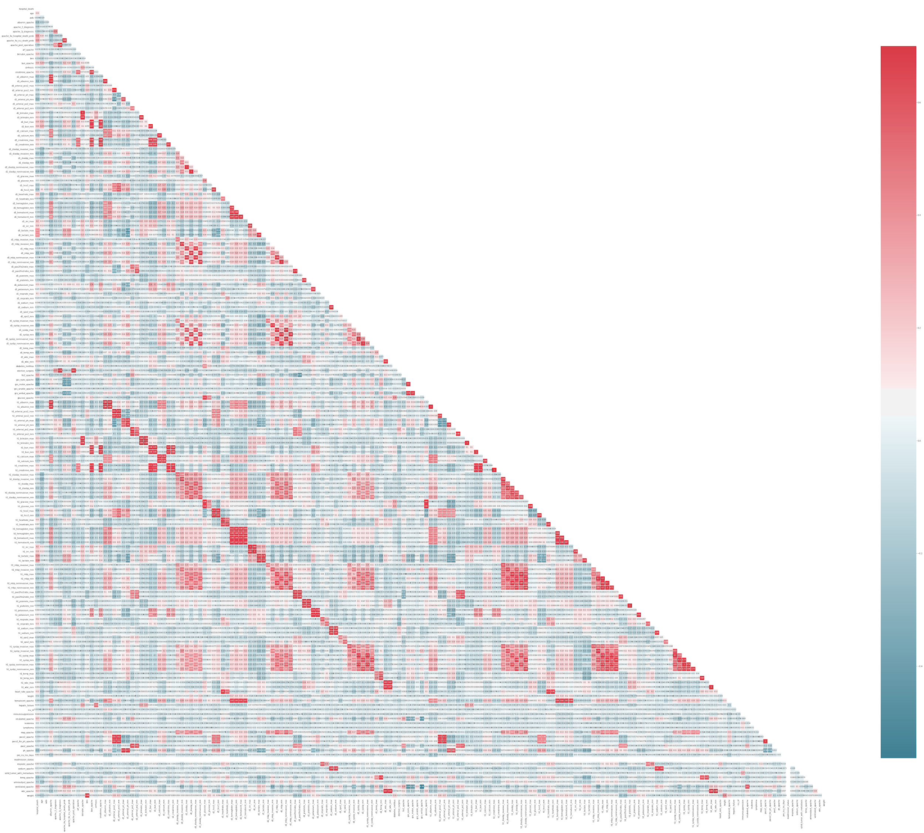
Correlated features
There are 44 pairs of features with very high correlation (i.e. 0.95 or more).

Slide 38
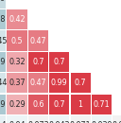
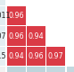
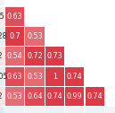
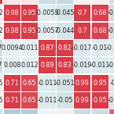
Correlated features
There are 44 pairs of features with very high correlation (i.e. 0.95 or more).
Lots of features express the same exact phenomenon, and these correlated features are very often close to the diagonal.

Slide 39
Correlated features
There are 44 pairs of features with very high correlation (i.e. 0.95 or more).
Lots of features express the same exact phenomenon, and these correlated features are very often close to the diagonal.
⇒ Redundant information

Slide 40
Correlation with the target variable
Not every feature is well correlated with the target variable.

Slide 41
Correlation with the target variable
Not every feature is well correlated with the target variable.
There are 54 features with very low correlation with the target variable (i.e. less than 0.05).

Slide 42
What can we do?

Slide 43
What can we do?
Dimensionality reduction!

Slide 44
Unbalanced dataset
There is a severe skew in the class distribution.

Slide 45
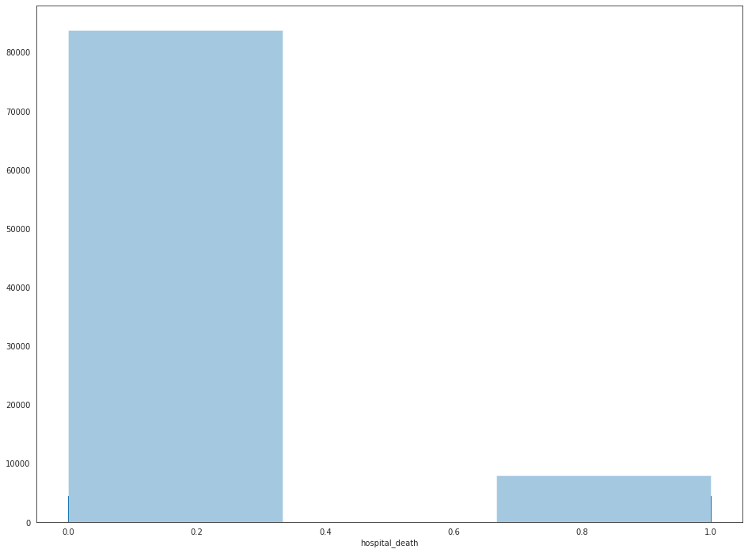
Unbalanced dataset
There is a severe skew in the class distribution.
83798 encounters with class 0 (91.37% of the dataset)
7915 encounters with class 1 (8.63% of the dataset)

Slide 46
How to handle unbalanced datasets?
There are two phases in which unbalanced datasets represent a problem.

Slide 47
How to handle unbalanced datasets?
There are two phases in which unbalanced datasets represent a problem.
Splitting of the dataset

Slide 48
How to handle unbalanced datasets?
There are two phases in which unbalanced datasets represent a problem.
Splitting of the dataset
Problem: we could end up with very few instances from the minority class in the testing set
Solution: stratified random sampling

Slide 49
How to handle unbalanced datasets?
There are two phases in which unbalanced datasets represent a problem.
Splitting of the dataset
Problem: we could end up with very few instances from the minority class in the testing set
Solution: stratified random sampling
Training of the model

Slide 50
How to handle unbalanced datasets?
There are two phases in which unbalanced datasets represent a problem.
Splitting of the dataset
Problem: we could end up with very few instances from the minority class in the testing set
Solution: stratified random sampling
Training of the model
Problem: the bias in the training set could lead to ignore the minority class
Solution: undersampling/oversampling

Slide 51
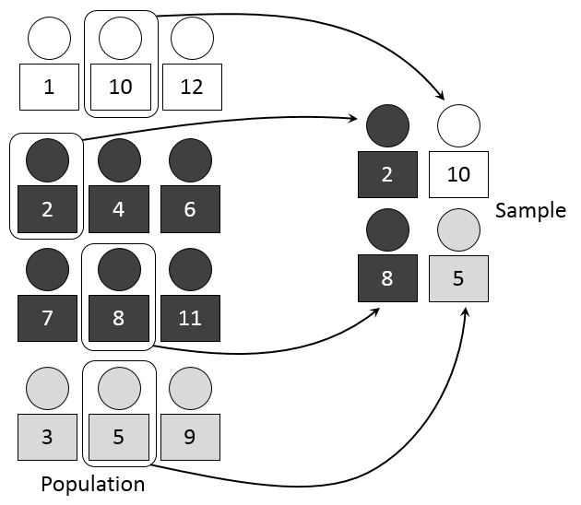
Stratified random sampling
Split the dataset in training and testing in a stratified fashion, that is, maintaining the initial class distribution after the splitting.

Slide 52
Undersampling and oversampling
Undersampling: remove examples from the majority class

Slide 53
Undersampling and oversampling
Undersampling: remove examples from the majority class
Oversampling: duplicate examples from the minority class

Slide 54
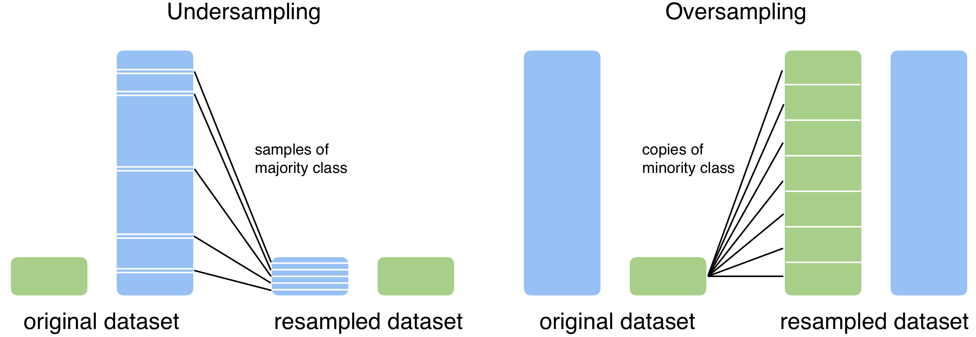
Undersampling and oversampling
Undersampling: remove examples from the majority class
Oversampling: duplicate examples from the minority class

Slide 55
Learning pipeline

Slide 56
Splitting the dataset
First thing we need to do is splitting the data in training and testing.

Slide 57
Splitting the dataset
First thing we need to do is splitting the data in training and testing.
We saw that the data is very unbalanced.

Slide 58
Splitting the dataset
First thing we need to do is splitting the data in training and testing.
We saw that the data is very unbalanced.
Stratified random sampling

Slide 59
Splitting the dataset
First thing we need to do is splitting the data in training and testing.
We saw that the data is very unbalanced.
Stratified random sampling
Training set size: 73553 rows (80%)
Testing set size: 18160 rows (20%)

Slide 60
Splitting the dataset
First thing we need to do is splitting the data in training and testing.
We saw that the data is very unbalanced.
Stratified random sampling
Training set size: 73553 rows (80%)
Testing set size: 18160 rows (20%)
From now on, we are going to work with just the training dataset.

Slide 61
Pipeline for missing values
Building a pipeline means that later we can apply the same transformations to other dataframes.

Slide 62
Pipeline for missing values
Building a pipeline means that later we can apply the same transformations to other dataframes.
Let M be the percentage of missing values for column c.

Slide 63
Pipeline for missing values
Building a pipeline means that later we can apply the same transformations to other dataframes.
Let M be the percentage of missing values for column c.
If M > 80% ⇒ remove column c

Slide 64
Pipeline for missing values
Building a pipeline means that later we can apply the same transformations to other dataframes.
Let M be the percentage of missing values for column c.
If M > 80% ⇒ remove column c
If M ≤ 80%:

Slide 65
Pipeline for missing values
Building a pipeline means that later we can apply the same transformations to other dataframes.
Let M be the percentage of missing values for column c.
If M > 80% ⇒ remove column c
If M ≤ 80%:
If c is a numerical feature ⇒ replace missing values with mean of column c

Slide 66
Pipeline for missing values
Building a pipeline means that later we can apply the same transformations to other dataframes.
Let M be the percentage of missing values for column c.
If M > 80% ⇒ remove column c
If M ≤ 80%:
If c is a numerical feature ⇒ replace missing values with mean of column c
If c is a categorical feature ⇒ replace missing values with mode of column c

Slide 67
Pipeline for correlated features
Let’s handle both features with low correlation with the target variable and highly correlated features.

Slide 68
Pipeline for correlated features
Let’s handle both features with low correlation with the target variable and highly correlated features.
Remove the features with very low correlation with the target variable

Slide 69
Pipeline for correlated features
Let’s handle both features with low correlation with the target variable and highly correlated features.
Remove the features with very low correlation with the target variable
Collect pairs of highly correlated features

Slide 70
Pipeline for correlated features
Let’s handle both features with low correlation with the target variable and highly correlated features.
Remove the features with very low correlation with the target variable
Collect pairs of highly correlated features
From every pair, remove the feature which has the lowest correlation with the target variable

Slide 71
Oversampling
Undersampling didn't work as a strategy, because it discarded too much useful information.

Slide 72
Oversampling
Undersampling didn't work as a strategy, because it discarded too much useful information.
With oversampling, we ended up with a pretty big (but balanced) dataset.

Slide 73
Oversampling
Undersampling didn't work as a strategy, because it discarded too much useful information.
With oversampling, we ended up with a pretty big (but balanced) dataset.
Oversampled training dataset size: 134425 rows

Slide 74
Oversampling
Undersampling didn't work as a strategy, because it discarded too much useful information.
With oversampling, we ended up with a pretty big (but balanced) dataset.
Oversampled training dataset size: 134425 rows
67248 in class 1
67204 in class 0

Slide 75
Random Forests
An ensemble method resulted to be a real suitable choice. It handled the dimension and the distribution of the values appropriately.

Slide 76
Random Forests
An ensemble method resulted to be a real suitable choice. It handled the dimension and the distribution of the values appropriately.
To build the model, I followed the following steps:

Slide 77
Random Forests
An ensemble method resulted to be a real suitable choice. It handled the dimension and the distribution of the values appropriately.
To build the model, I followed the following steps:
Search for the best hyperparameters on a sampled dataset (i.e. 10% of training set)

Slide 78
Random Forests
An ensemble method resulted to be a real suitable choice. It handled the dimension and the distribution of the values appropriately.
To build the model, I followed the following steps:
Search for the best hyperparameters on a sampled dataset (i.e. 10% of training set)
Train the model with the best hyperparameters on the entire training set

Slide 79
Hyperparameters tuning
Take 10 percent of the data

Slide 80
Hyperparameters tuning
Take 10 percent of the data
Build a grid of parameters to search over

Slide 81
Hyperparameters tuning
Take 10 percent of the data
Build a grid of parameters to search over
3 parameters for the max depth of the trees
3 parameters for the number of trees

Slide 82
Hyperparameters tuning
Take 10 percent of the data
Build a grid of parameters to search over
3 parameters for the max depth of the trees
3 parameters for the number of trees
Train the model with cross validation over the grid of parameters

Slide 83
Hyperparameters tuning
Take 10 percent of the data
Build a grid of parameters to search over
3 parameters for the max depth of the trees
3 parameters for the number of trees
Train the model with cross validation over the grid of parameters
To choose the best parameters, I then compared the area under the ROC curve computed across every model setting.

Slide 84
Evaluation

Slide 85
ROC - PR
Following the pipeline we used for the training data on the testing one, we were able to apply our model on it and predict the values.

Slide 86
ROC - PR
Following the pipeline we used for the training data on the testing one, we were able to apply our model on it and predict the values.
ROC AUC = 0.885

Slide 87
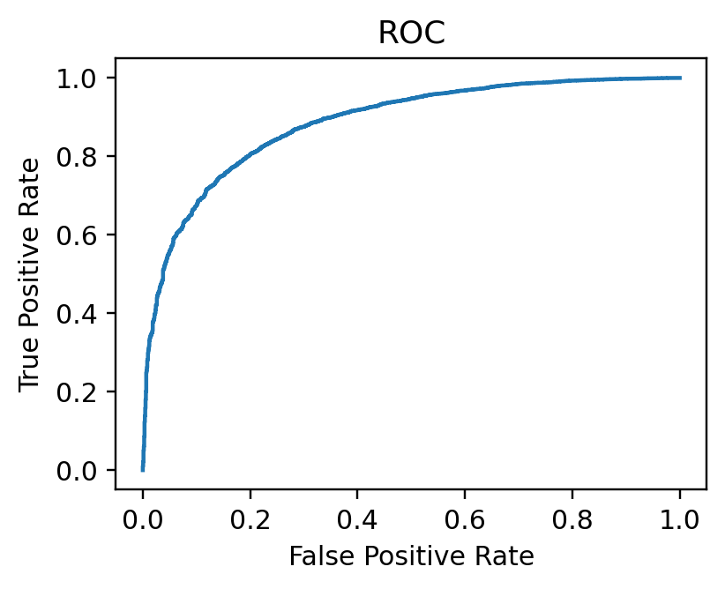
ROC - PR
Following the pipeline we used for the training data on the testing one, we were able to apply our model on it and predict the values.
ROC AUC = 0.885

Slide 88
ROC - PR
Following the pipeline we used for the training data on the testing one, we were able to apply our model on it and predict the values.
ROC AUC = 0.885
PR AUC = 0.986

Slide 89
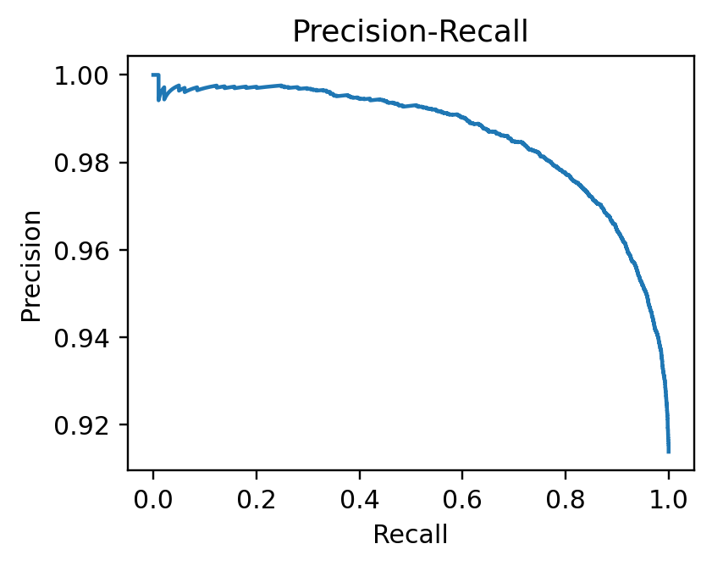
ROC - PR
Following the pipeline we used for the training data on the testing one, we were able to apply our model on it and predict the values.
ROC AUC = 0.885
PR AUC = 0.986

Slide 90
Extra - Kaggle submission

Slide 91
Predict the unlabeled instances
The challenge was to predict the probability of patient survival.

Slide 92
Predict the unlabeled instances
The challenge was to predict the probability of patient survival.
Once more, I applied the usual pipeline to the entire dataset (train + test).

Slide 93
Predict the unlabeled instances
The challenge was to predict the probability of patient survival.
Once more, I applied the usual pipeline to the entire dataset (train + test).
Then, I re-trained the model on the entire dataset (oversampled).

Slide 94
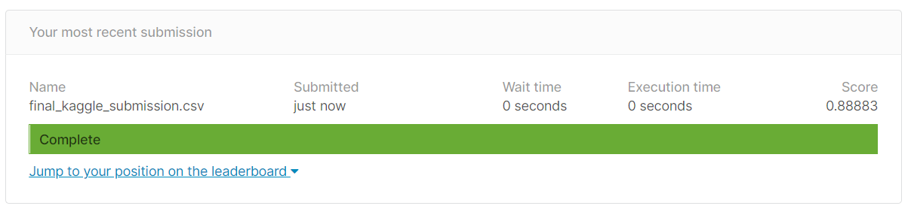
Predict the unlabeled instances
The challenge was to predict the probability of patient survival.
Once more, I applied the usual pipeline to the entire dataset (train + test).
Then, I re-trained the model on the entire dataset (oversampled).

